Slide 1
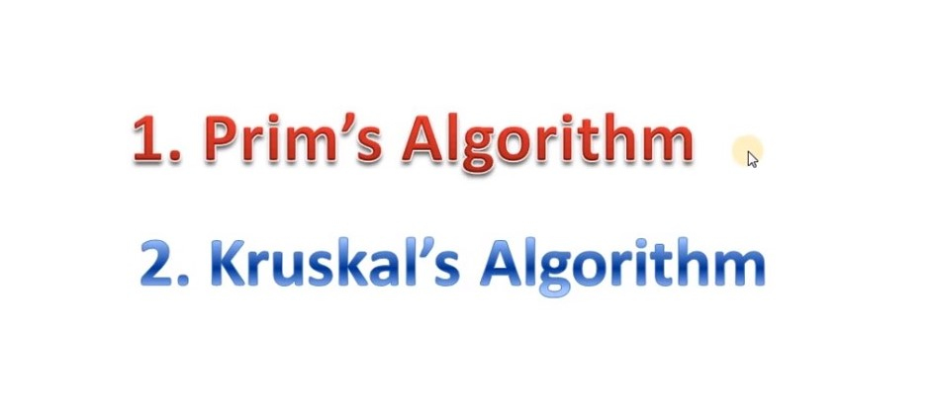
Minimum Spanning Tree

Slide 2
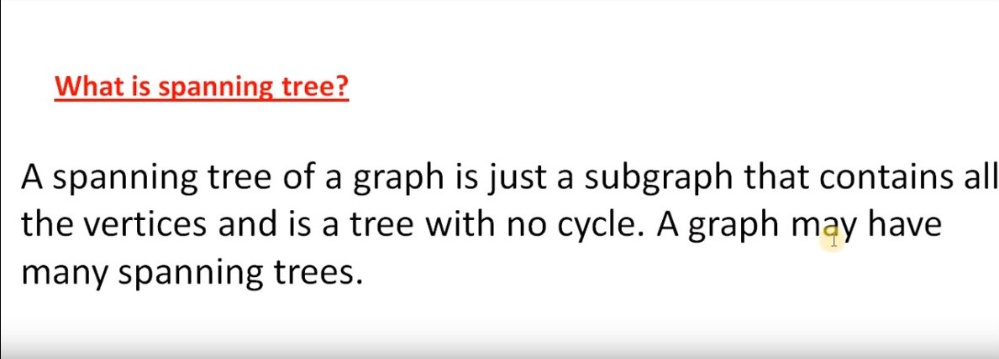

Slide 3
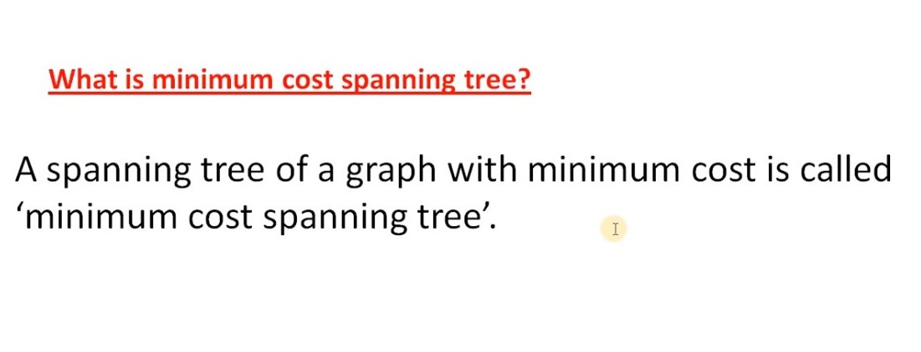

Slide 4
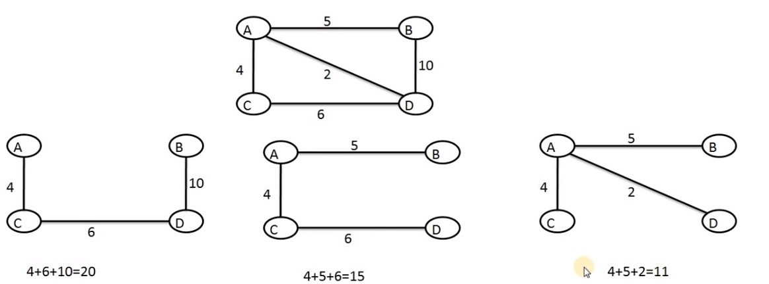

Slide 5
Kruskal’s Algorithm
Sort all the edges in non-decreasing order of the weight
Pick the smallest edge.
Check if it forms a cycle with the spanning tree skip it if not add it in the tree.
Repeat step #2 until there are V-1 edges in the tree

